Slide 1


External Business Analysis
Assignment 2

Slide 2



Table of Contents
PESTLE Analysis: The Body Shop in the United Kingdom
Porter’s Diamond: Perfume in France
Porter’s Five Forces: Financial Education Crew in India

Slide 3
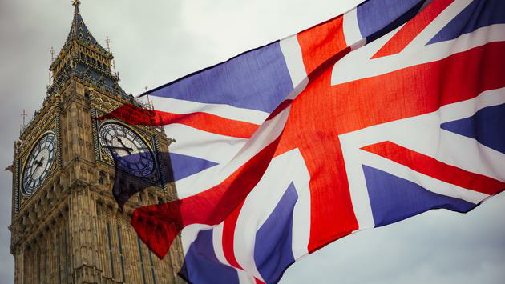
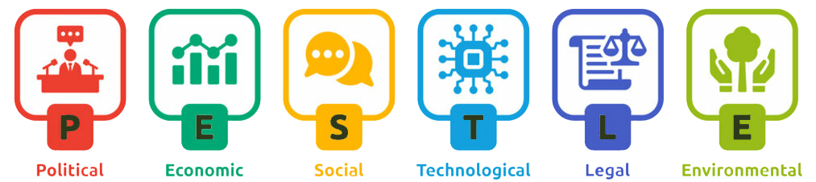
PESTLE Analysis

Slide 4
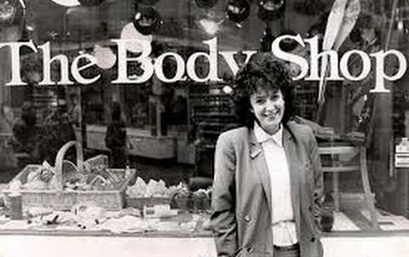
The Body Shop
They started in 1976 with their founder, Anita Roddick. She opened a little green shop in Brighton with the belief in something revolutionary: that business could be a force for good.

Slide 5



PESTLE: The Body Shop
Political
Economic
Social
Brexit
Government Regulations
Ukraine War
Inflation
Economic Growth
Increase cost of supply chain
Exchange Rate
Increased Demand of ethical and sustainable products
Health and Wellness trends like the Hemp Range in India
Loyalty programs
Notes:
Political: Brexit: The UK's departure from the European Union results in changes to trade and import regulations that could impact The Body Shop's supply chain and operations. shift business operations to Germany. Decline in the ethical standard of cosmetics as a result of Brexit would attract new customers to TBS as the company continues to comply with the EU standard of product quality and consumer safety
Government regulations: The UK government has implemented several regulations in the cosmetics industry, including packaging and labeling requirements, which could impact the Body Shop's operations.
Ukraine war: stopped dealing with Russia and supported the war effort by allocating 700K pound
Economic: Inflation: affected consumer behavior. Inflation rates can affect consumer spending and purchasing power, which could impact The Body Shop's sales.
Economic growth: The UK's economic growth can impact consumer confidence, which in turn affects sales.
Increased cost of managing the supply chain operations due to the Ukrainian war, they managed by extending donations and support to the victims of the crisis
The exchange rate plays an important role for multinational companies that have suppliers all around the world. The revenues the company generates in stores outside the euro zone need to be exchanged for euro and the many communities that supply ingredients for the cosmetics are paid in their national currency. Consequently, the exchange rate has a great influence on the company's revenues.
Social: Growing demand for ethical and sustainable products: The Body Shop has always been committed to ethical and sustainable practices, and this trend in consumer preferences could benefit the company.
Health and wellness trends: Consumers are increasingly concerned about the health effects of the products they use, which could impact the Body Shop's product development and marketing strategies.
Works on loyalty by having loyalty programs
hemp range products while legal, due to people's perceptions they stopped selling it in India except in big cities as people couldn’t accept buying hemp products

Slide 6



PESTLE: The Body Shop
Technological
Legal
Environmental
E-Commerce
Use of Social Media
Rise in popularity of personalized products
Competition Law
Employment Law
Taxation, trading and hiring practices
Climate Change
Sustainable Sourcing
Greenhouse Gas Emission
Notes:
Technological: E-commerce: The rise of e-commerce has changed the way consumers shop, and The Body Shop needs to keep up with this trend by investing in online sales channels.
Use of social media: Social media is a powerful tool for marketing and customer engagement, and The Body Shop needs to use it effectively to reach out to customers.
Rise in popularity of product personalization and the use of AI-software that tailors beauty recommendations for every individual, would reduce brand loyalty as the perceived risk of trying new skincare products decreases
Legal: Competition law: The Body Shop needs to comply with competition law in the UK, which can affect its pricing and promotional strategies.
Employment law: The Body Shop needs to comply with employment laws in the UK, including minimum wage requirements and health and safety regulations.
Adhering to taxation, trading, hiring practices. In the past they had to deal with a lawsuit in Austria (Nisse, 1999).
Environmental: Climate change: The Body Shop is committed to reducing its environmental impact, and climate change could impact its supply chain and operations.
Sustainable sourcing: The Body Shop needs to ensure that its products are sourced sustainably to meet the growing demand for eco-friendly products.
Developed the goal of reducing the greenhouse gas emission to net zero by the end of 2030, indicating the focus on environment friendly business practices

Slide 7
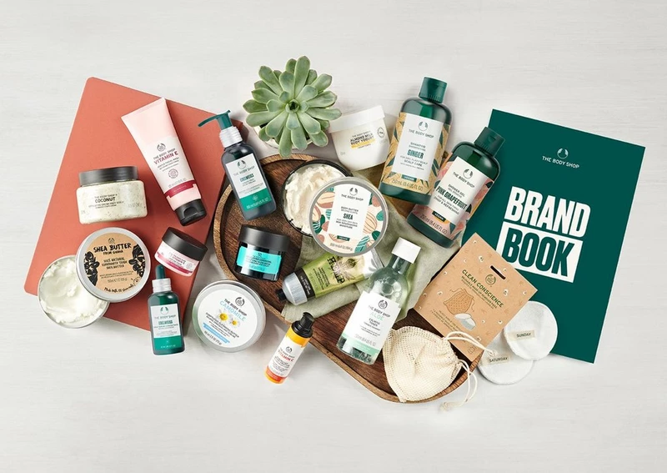
PESTLE: The Body Shop
Conclusion
The body shop has been able to create a positive image in the market and maintained a customer base.
Issues such as increased inflation and interest have disturbed the sales volume, nevertheless, the ethical and environment friendly stance and quality of products has been able to serve as a defining feature of the company, creating a loyal customer base.
Overall, The Body Shop operates in a dynamic macro-environmental environment that presents both opportunities and challenges. By keeping a close eye on these factors, the company can adapt its strategies and operations to stay ahead of the competition and meet customer demands.

Slide 8
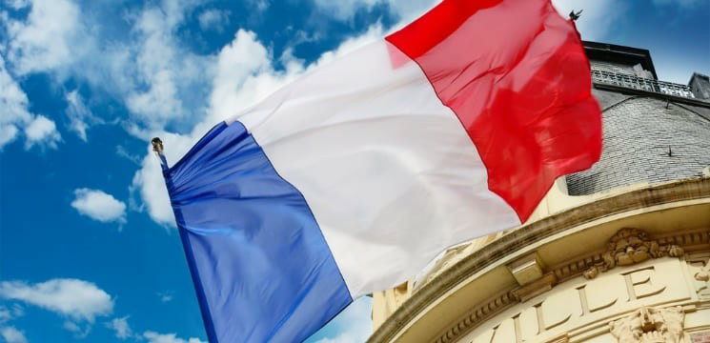
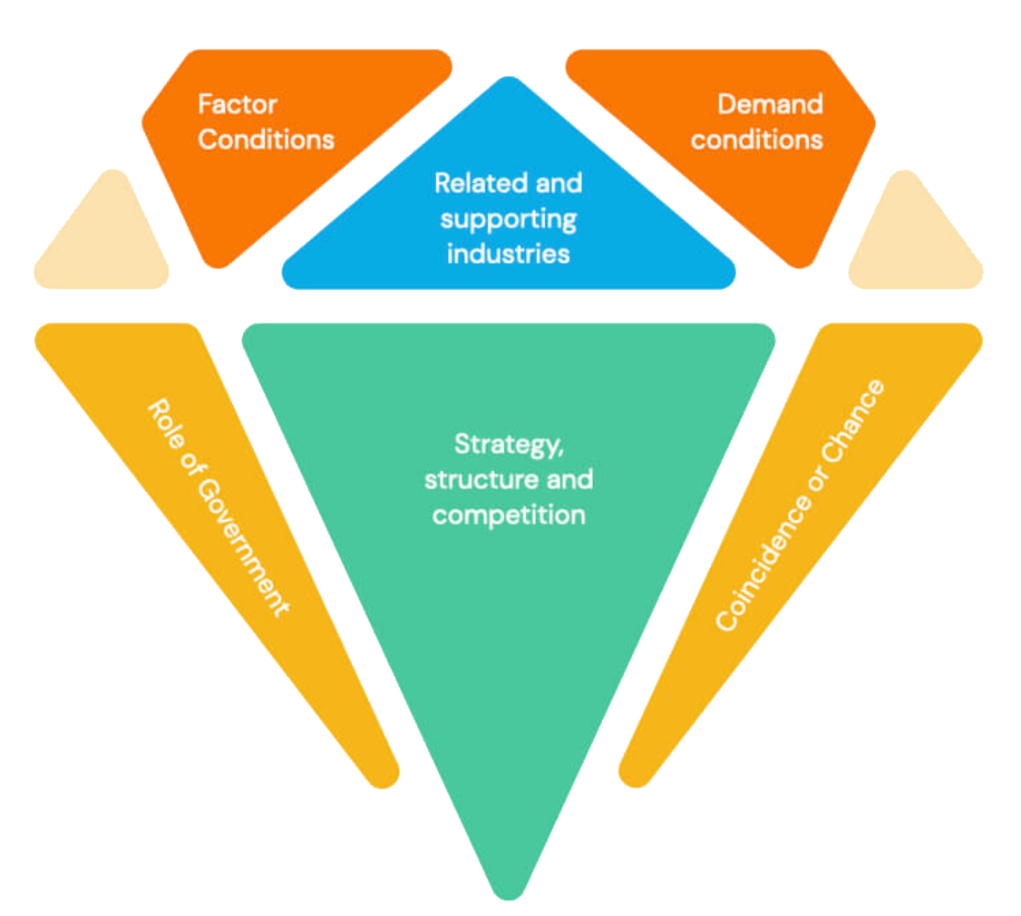
Porter’s Diamond Model

Slide 9
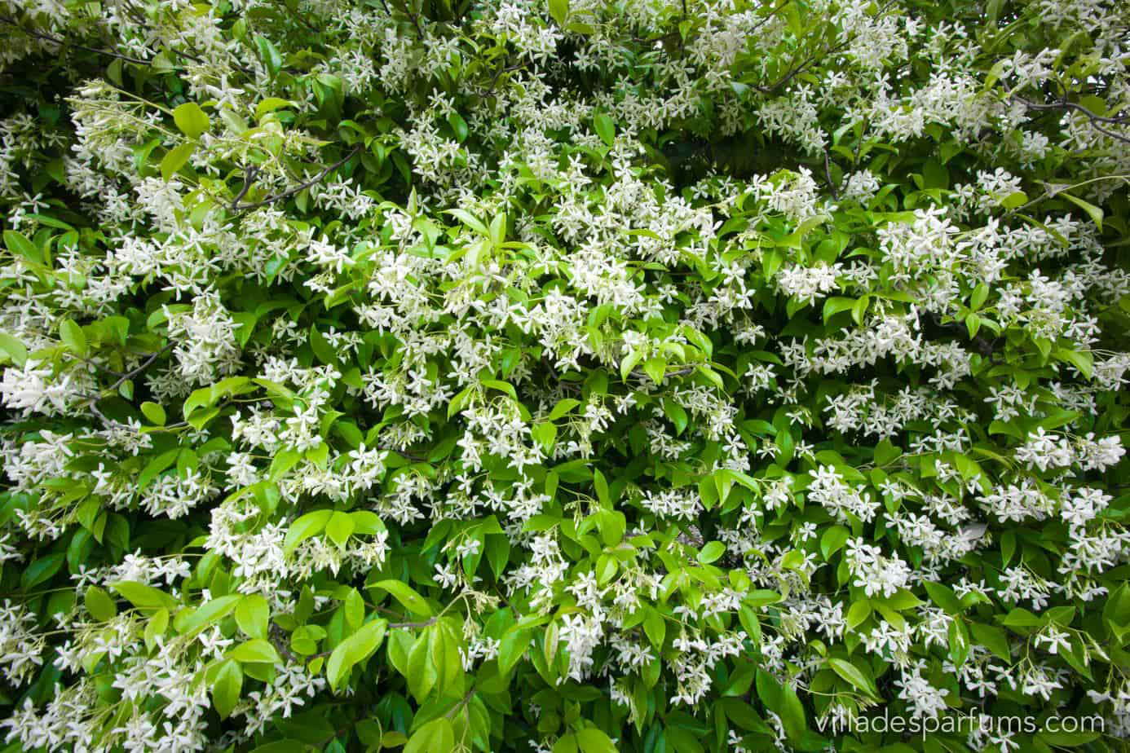
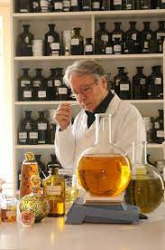
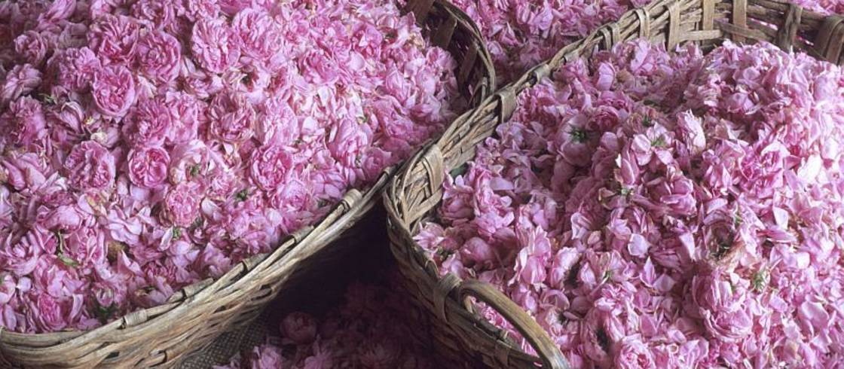


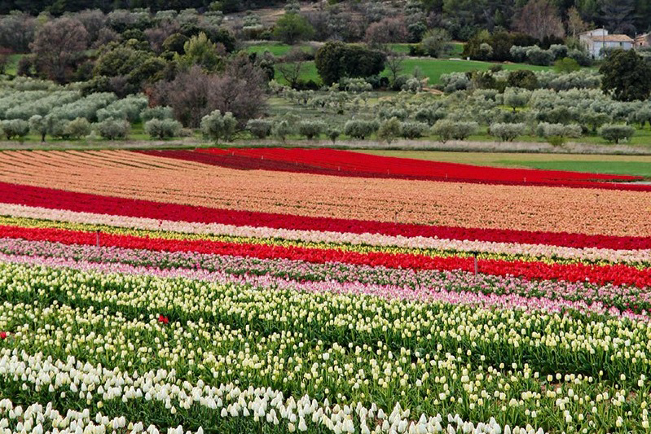
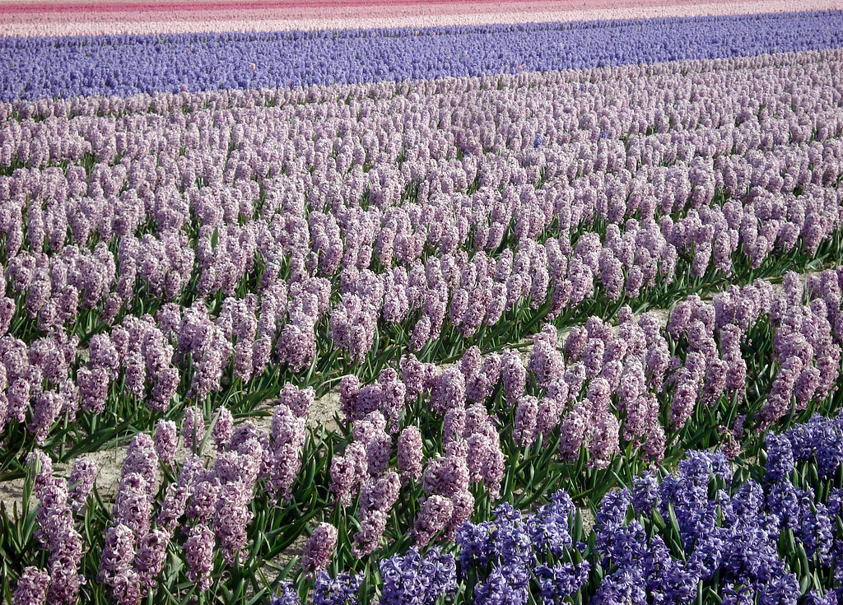
Perfume in France
The perfume capital of the world is not just a title. It is a lifestyle that has driven the 50,000 residents of Grasse since the 17th Century
The art of perfume making is so much engrained in the French that they prefer to produce perfumes from natural extracts with special methods and techniques handed down from generations of perfumers rather than relying on modern technology
Factor Conditions:
Optimal weather for farming perfume ingredients
Fabulous farms and farming techniques
Presence of perfume experts (Noses and Generational perfumers)
€650m for research and development
Notes:
The perfume capital of the world is not just a title. It is a lifestyle that has driven the 50,000 residents of Grasse since the 17th Century. The small town has optimal factors ranging from optimal weather conditions for farming perfume ingredients, including jasmine, rose, mimosa and orange blossom; to the fact that 20% of the residents of Grasse are actually employed in that exact sector. In fact, the art of perfume making is so much engrained in the French that they prefer to produce perfumes from natural extracts with special methods and techniques handed down from generations of perfumers rather than relying on modern technology. In addition, the presence of perfume specialists called “Noses”, the name being self explanatory, make France the premier destination for sourcing materials, blending and creating exquisite smells, and solidifying its premiumness for all top perfume brands in the world.
Factor Conditions:
Optimal weather for farming perfume ingredients
Fabulous farms and farming techniques
Presence of perfume experts (Noses and Generational perfumers)

Slide 10
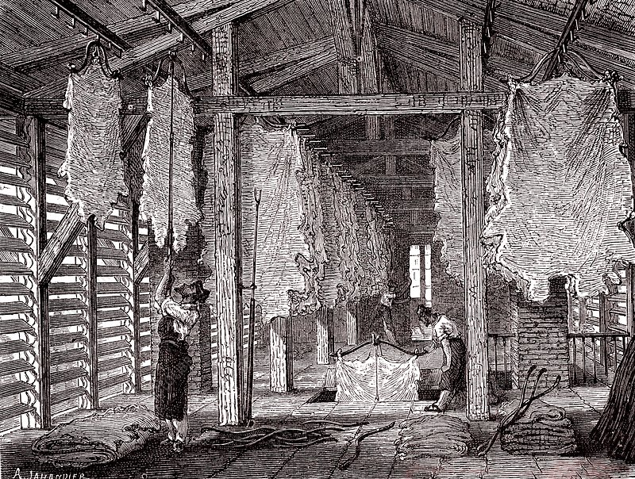
Perfume in France
The high demand from the French gave rise to better and more world-class perfumes and as of today The women’s fragrance segment is projected to reach USD 37.2 billion by 2023, compared to USD 23.8 billion for the men’s fragrance segment.
Demand Conditions:
Extreme smells due to leather industry
Higher competition = better quality products (Early Saturation)
Perfume usage by men and women alike
Notes:
So what led to so many people accepting an industry and way of life in such massive scale? As we all know necessity is the mother of all inventions, and the town of Grasse felt a similar necessity for Fragrances at the turn of the 17th century. At that time, the area was famous for its leather industry, and as we all know dead animals are somewhat of a collateral damage when it comes to making leather. Long story short, the putrid smell and the horrific working conditions simply due to smell gave rise to the huge demand for perfumes and they have stuck to their guns ever since. But that was back in the days of yore. Nowadays, The French are known for their good taste and high fashion style so the various brands within the industry have had to work hard and innovate to meet the needs of such demanding customers. The high demand from the French gave rise to better and more world-class perfumes and as of today The women’s fragrance segment is projected to reach USD 37.2 billion by 2023, compared to USD 23.8 billion for the men’s fragrance segment.
Demand Conditions:
Extreme smells due to leather industry
Higher competition = better quality products (Early Saturation)
Perfume usage by men and women alike

Slide 11
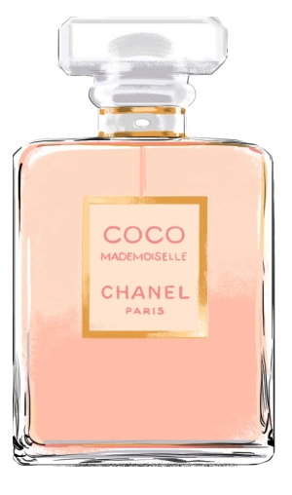


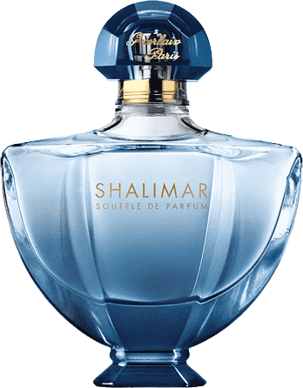
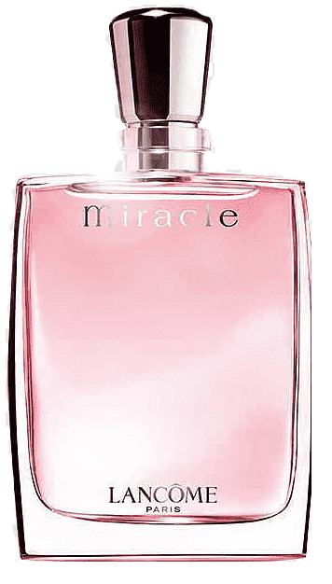

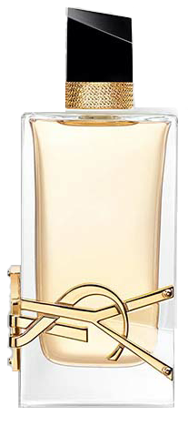
Perfume in France
The high skilled workforce and the diversification done by the fashion brands to expand the perfume sector has directly supported the growth of the luxury status of perfumes in France too.
Related and Supporting Industry:
Fashion and luxury good industry
€150 billion in turnover
2.7% of the French GDP
Notes:
The fashion and luxury goods industry is also a big reason for the fragrance industry to do so well. It has a direct turnover of €150 billion. The share of French GDP generated by fashion is 2.7% and there are 1 million jobs in the fashion industry. The high skilled workforce and the diversification done by the fashion brands to expand the perfume sector has directly supported the growth of the luxury status of perfumes in France too. With everything from the flowers and the craftsmanship to the presence of a luxury and high fashion driven economy, everything has worked out in favor of the Perfume industry in France.
Related and Supporting Industry:
Fashion and luxury good industry
€150 billion
2.7% of the French GDP
1 million specialized jobs

Slide 12
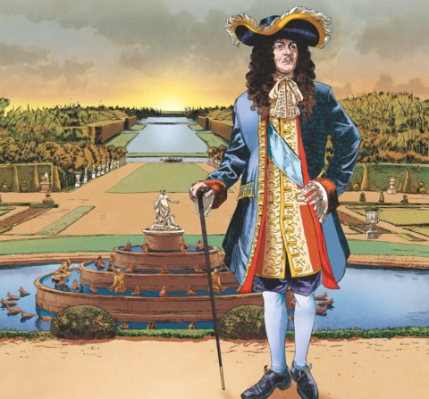
Perfume in France
Firm Strategy, Structure and Rivalry
High competition amongst French brands
Presence of perfumery structures dating far back as 1747.
Government:
Louis XIV polices on daily production of new scents
France has very strict regulations and safety requirements (boost innovation)
Notes:
Even the French Royalty has had a say when it comes to solidifying the image of France as a hub for everything luxurious. King Louis XIV, the country’s most fashionable royalty recognized the importance of luxury goods to the national economy. Under his leadership, the country developed a powerful textile industry which in turn boosted trading and the country’s infrastructure. Not to mention the conditions that we mentioned in the beginning which led to the perfume also followed a similar route with the goal of being the premier destination for all things aromatic. There’s also intense competition among high fashion French brands such as Chanel, Dior, Guerlain, Chloe, Thierry Mugler, Yves Saint Laurent, and Lancome come from France for the market share.
Firm Strategy, Structure and Rivalry
Steady focus since the Age of Enlightenment
Bourgeoisie and Cultured Nuances
Goal to be luxury oriented
High Competition among French Brands

Slide 13
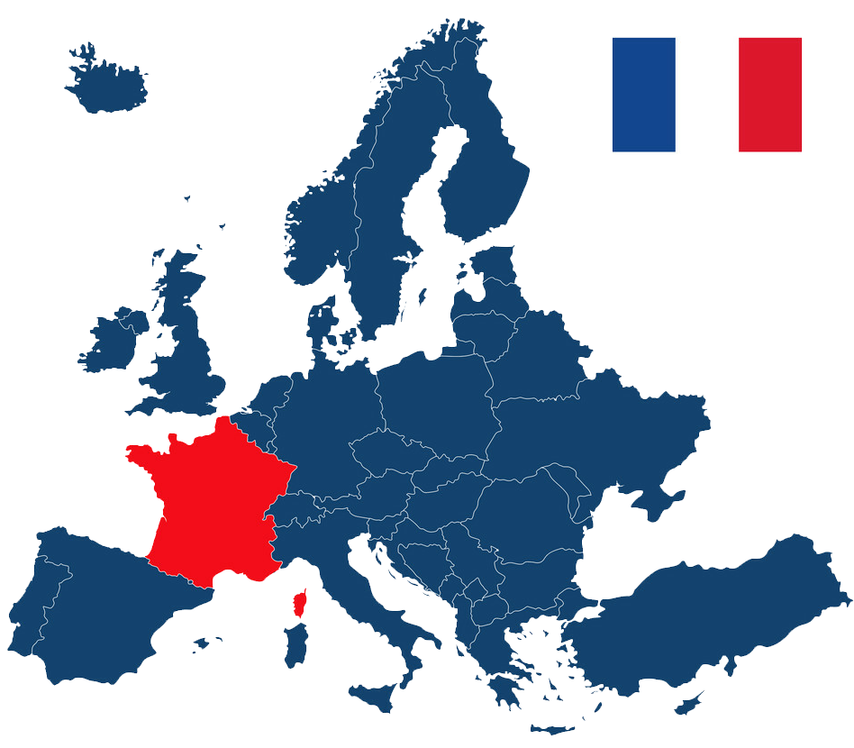
Perfume in France
Therefore, as we can see, in a series of very fortunate events, France has come out as the Perfume Capital of the world. We can see the Porter’s Diamond in play throughout this rise and changing societal demands, the industry continues to evolve and adapt. It will be interesting to see how the French, in staying the perfume capital of the world, are able handle competitive threats in the coming years
Notes:
Therefore, as we can see, in a series of very fortunate events, France has come out as the Perfume Capital of the world. We can see the Porter’s Diamond in play throughout this rise and with the changing society and demands, the industry continues to evolve and adapt. It will be interesting to see how the French handle the changing climate conditions and the ever so changing EU regulations that currently force France to have the most stringent regulations and product safety requirements in the world and still retain their spot at the top.

Slide 14
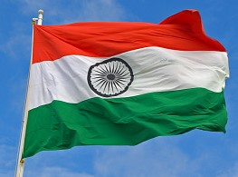
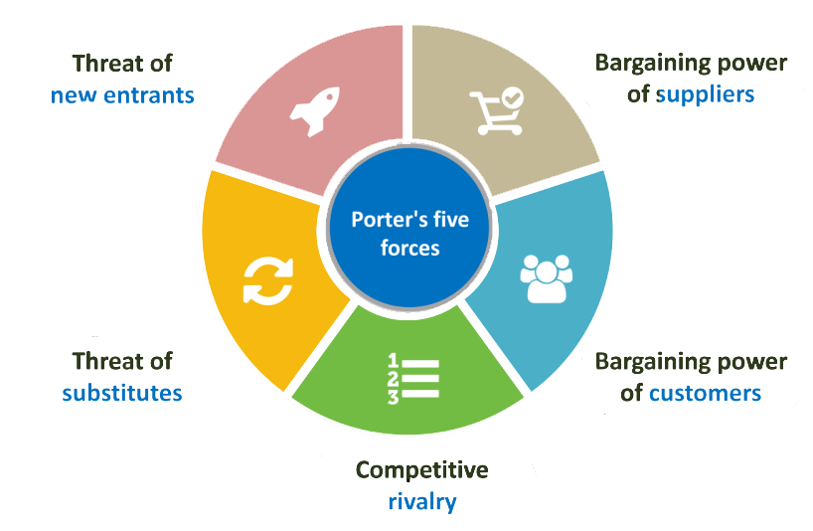
Porter’s Five Forces

Slide 15
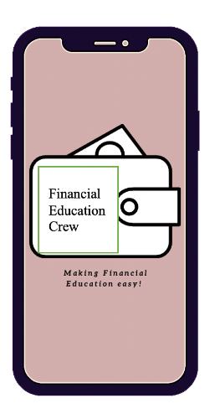

Financial Education Crew
Business in one line – Enabling financial wellbeing and freedom through financial education
What does the business do – Online and in person financial education for students over 10 years of age and women
What does the brand stand for – Providing high-quality, interactive financial education to young adults that enables financial well-being and freedom.
As per Securities exchange board of India (SEBI) only 27% of the country's population has financial literacy.

Slide 16
Log in
Multiple options available in the menu bar
- Financial concepts videos. - Advance courses.
- Budgeting feature - Latest updates
- Quiz - Lead board - Certificate download
Reward Points for top place on the quiz and referring the app.
Checkout
Financial Education Crew

Slide 17
Barging Power of Customers
No of customers 76% Indians
Orders size - students each order size is 30-35 students, For women it’s either online where the batches will be 20 to 25 participants
Economics of scale - While 1.3 billion Indians live in the country, only 27 % of them understand and participate in the markets and 70% or more are illiterate about financial concepts (IBEF, 2022) logo added
Price sensitivity- Low (new education policy makes its compulsory)
Ability to substitute - yes
Cost of change - Money wise expensive, effort wise expensive as well

Slide 18



Competitive Rivalry
Operations
Free Financial Education as a part of their CSR initiatives.
Financial education for low and middle class families
They provide debit cards to kids and advice parents to allow kids to use those cards
Other Differences
Just learning
Converts them into clients for financial planning
Sort of like a bank
Cost of change / Switching cost
Change in management fee
The money needs to be transferred to another bank
None at the moment
Customer Loyalty
High
Medium
Medium
Cost of Leaving
Capital gain tax or loss
Capital gains and professional management
99 rupees (1 pound) card fees
Notes:
High because at the end people will still invest with them
Medium Financial Planning
Medium Cashbacks

Slide 19
Threat of Substitute Products
Medium as they are free financial education provider
Medium to High
By sept 2022 their target was 50,000 clients in tier 2 and 3 cities in 23 states in India
Medium to high
As of now 1 million users (10 lakhs)
Substitute Performance
None at the moment as it’s a CSR initiative
Change in management fee
The money needs to be transferred to another bank or utilized
Cost of change / Switching cost

Slide 20




Power of Suppliers
Creative and Design
Patent Lawyers
Digital Media
App Developers
Size of Suppliers
High
High
High
High
Uniqueness of Supplies
Help us with making the course more interactive
Help us with getting copyright
Create digital presence
Create the platform
Ability to Substitute
Easy - Yes
Slightly difficult - Yes
Easy - Yes
Slightly difficult - Yes
Cost of Change
Medium
High
Medium
High

Slide 21
Thank You
Emma Cohen - Ikenna Daniel Nwankwo - Lamis Salloum Yared - Rohan Upadhaya - Vaishnavi Pritam Veer

